Slide 1
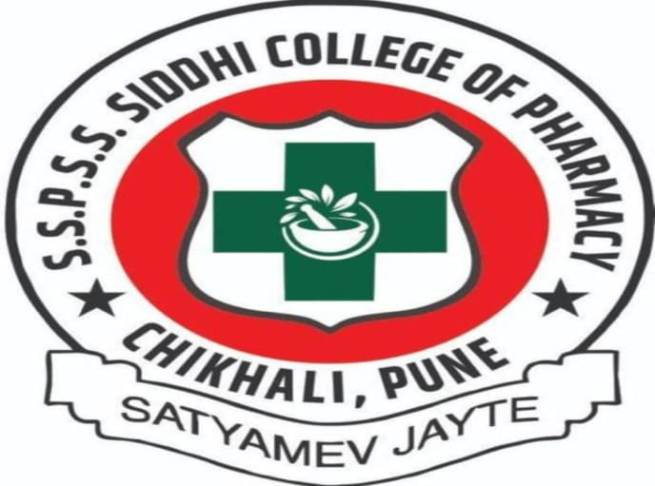
S.S.P Shikshan Sanstha’s
SIDDHI COLLEGE OF PHARMACY
Newale Vasti, Chikhali , Pune – 411062
NAME : Vedant Santosh Waghule CLASS : Final Year B .Pharma
SUBJECT: Instrumental Method Of Analysis ROLL.NO : 457
THIRD CONTINUOUS MODE EXAM 2024-25

Slide 2
INDEX
Definition
Advantages
Applications

Slide 3
HIGH PERFORMANCE LIQUID CHROMATOGRAPHY
DEFINATION :
High-performance liquid chromatography (HPLC), formerly referred to as high-pressure liquid chromatography, is a technique in analytical chemistry used to separate, identify, and quantify specific components in mixtures. The mixtures can originate from food, chemicals, pharmaceuticals,^{[1]} biological, environmental and agriculture, etc., which have been dissolved into liquid solutions.

Slide 4
ADVANTAGES
Greater sensitivity (various detectors can be employed)
Improved resolution
Speed
Easy sample recovery (less eluent volume to remove)
A wide variety of stationary phases
High accuracy in separation of analytes
Reproducibility
Quick, automated, and simple data analysis

Slide 5
ADVANTAGES
High precision – HPLC (High-Performance Liquid Chromatography) is a highly precise method of separating and analyzing different components in a mixture.
High sensitivity – HPLC can detect and measure very small amounts of a substance, making it an ideal technique for detecting trace impurities or contaminants.
Wide range of applications – HPLC can be used to analyze a wide variety of substances, including drugs, proteins, and environmental pollutants.
Cost-effective – HPLC is relatively cost-effective when compared to other analytical techniques, making it accessible to many laboratories.
Speed – HPLC can separate and analyze a sample quickly, which is beneficial for time-sensitive research or analysis.

Slide 6
APPLICATIONS
Pharmaceutical Applications
To test the quality of drugs
To detect impurities
Manufacturing of pharmaceutical drugs
To monitor the progress of a therapy of a disease
Qualitative and quantitative analysis
Evaluating formulations
Monitoring changes during scale-up
Helps in tablet dissolution study
To control drug stability
2. Environmental Applications
Analytical control of pollutants
Detection of phenolic compounds in drinking water
Analyzing air pollution
Oil spills analyzing
Analyzing plastic pollution
3. Food and Flavour
Quality check for soft drinks and water
Sugar analysis in fruit juices
Preservative analysis
Polycyclic compound analysis
Used to separate various ingredients, contaminants, and additives
4. Applications in Forensics
Identification and quantification of drugs
Forensic analysis of textile dyes
Determination of cocaine and other drugs in blood
Help to analyze volatile substances
To determine the material used in explosives
5. Applications in Clinical Tests
To determine illicit drugs in urine
Antibiotics analysis in blood
Nutrient analysis
In hepatic disorders, for analysis of bilirubin, and biliverdin

